Slide 1
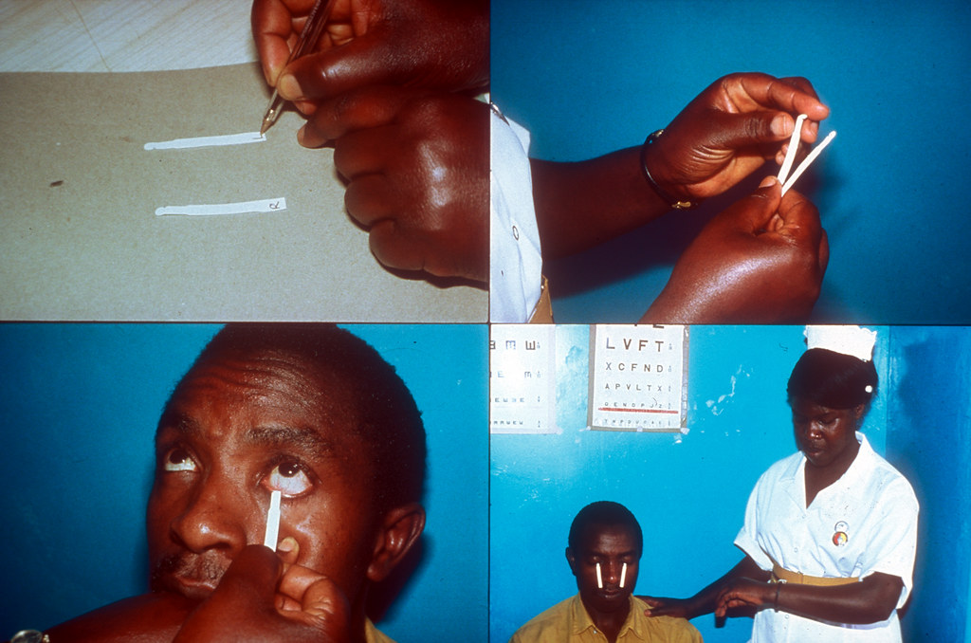
Assessing Impact of Digital Lens Usage On Eye Dryness using Schirmer’s Effect
By:
J.AJAY 21R11A05G8
L.REVANTH 21R11A05H4
S.SAI KUMAR 21R11A05K6
This Photo by Unknown Author is licensed under CC BY-NC

Slide 2

OUTLINE
Abstract
Introduction
Problem statement
Objectives
Methodology
Algorithms
Results
Conclusion

Slide 3
Outline
ABSTRACT
This study investigates the prevalence and risk factors of prolonged digital screen use on the eyes among undergraduate students
A cross-sectional survey was conducted to assess demographics, daily screen exposure, device types, visual symptoms, and preventive measures.
Statistical analysis identified significant risk factors, including longer screen exposure, frequent smartphone and computer use, inadequate breaks, and poor ergonomic practices.
Results highlighted a high prevalence of prolonged screen use among undergraduates, with many reporting eye strain, dryness, and discomfort.

Slide 4
Outline
INTRODUCTION
In recent years, the prevalence of digital screens in everyday life has surged dramatically, particularly among the undergraduate population.
Understanding the prevalence and risk factors associated with prolonged digital screen use among undergraduates is crucial for developing effective preventive measures.
The Schirmer test is a diagnostic test used by ophthalmologists and optometrists to evaluate tear production in the eyes.
Normal tear production typically ranges between 10 to 20 milli-meters of wetting of the filter paper within five minutes.

Slide 5
Outline
PROBLEM STATEMENT
Understanding the impact of digital screen usage on eye health and associated symptoms involves analysing various factors like age, duration of screen time, online platforms, nature of activities, screen illumination, years of exposure, daily screen hours, types of devices used, distance from the screen, nighttime usage, blinking frequency, difficulty in focusing, frequency and severity of complaints, observed ocular symptoms, and specific eye examination results.
By examining these variables, we aim to uncover patterns and correlations to develop strategies for maintaining optimal eye health in the digital age.

Slide 6
Outline
OBJECTIVES
Problem Definition and Scope
Data Collection and Preprocessing
Model Building and Evaluation
Interpretation, Deployment, and Reporting

Slide 7
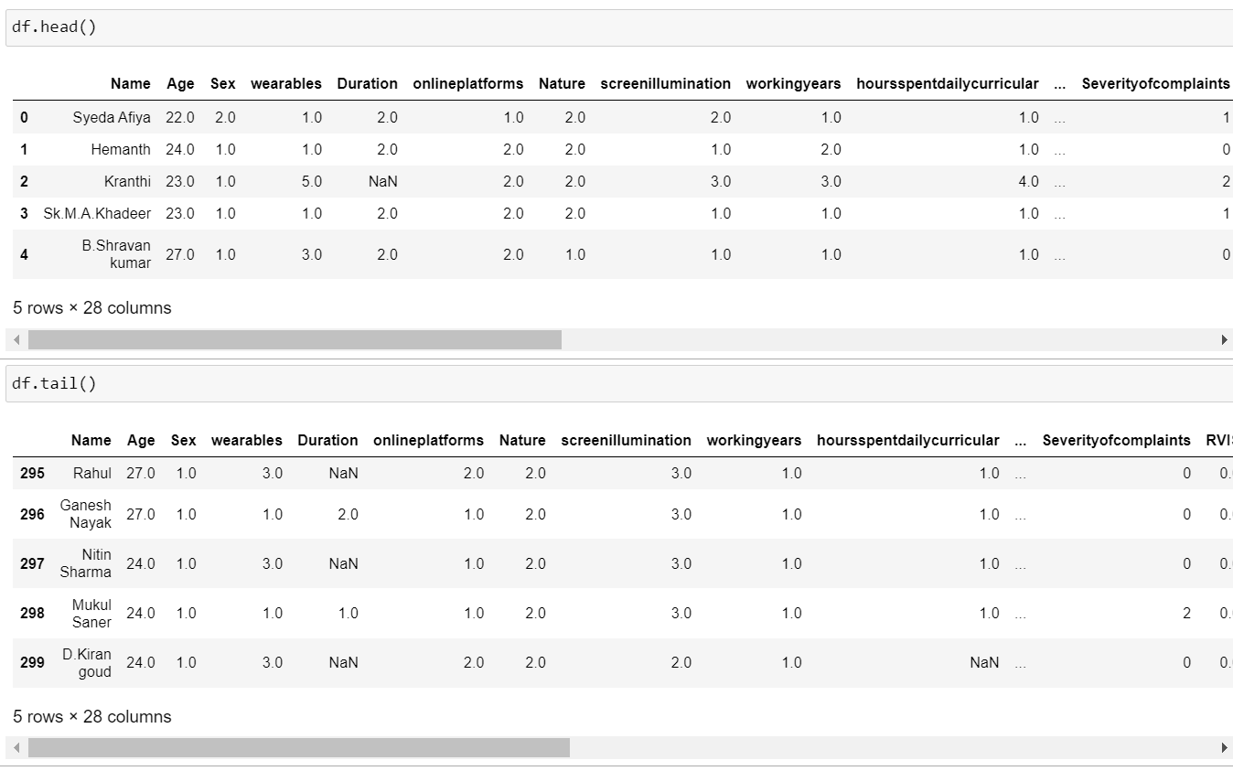
Outline
METHODOLOGY
The data comprised of 28 features and 300 observations.
Exploratory Data Analysis(EDA):
By performing EDA, we can identify any missing or erroneous data, outliers, and inconsistencies in the data, which can be addressed before training any machine learning models.
There is 27 numerical columns and 1 categorical column in the given dataset.
We can clearly ignore ‘Name’ column in the dataset as they only represent name of the undergraduates.

Slide 8
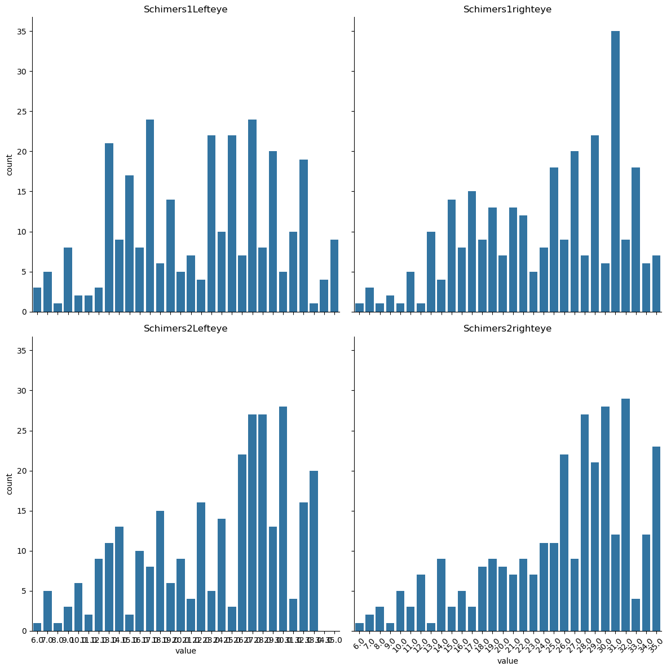
Outline
METHODOLOGY
Data Visualization:
Count plot for target variables:
Since the values in the target variables are continuous then we don’t need to do any balancing for these columns.
Test of Normality is done and not much variation is observed(Normal).

Slide 9
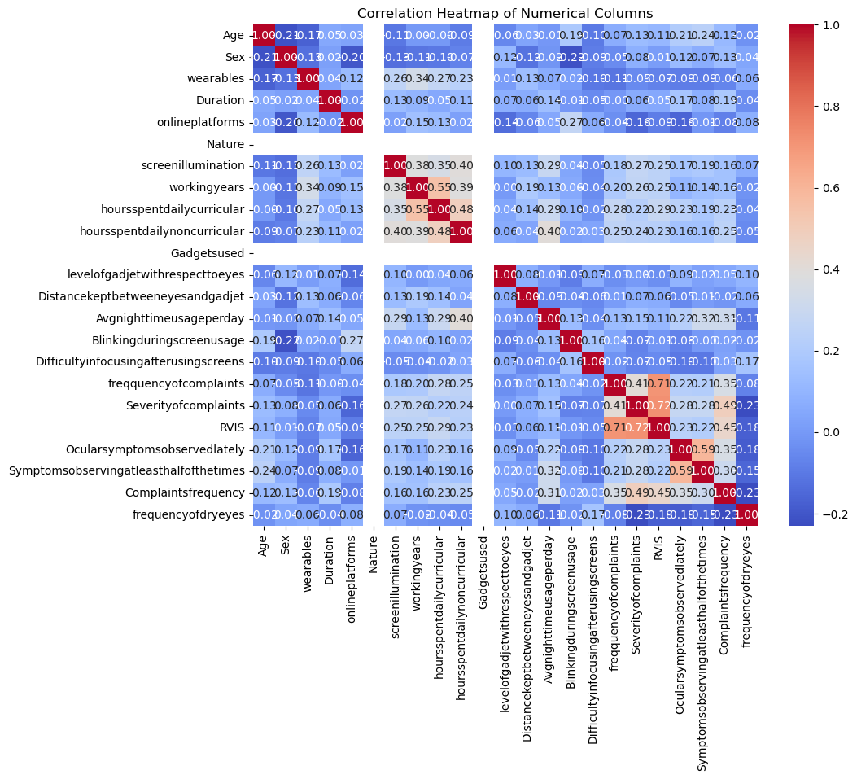
METHODOLOGY)
Correlation Heat Map:
A positive correlation is shown in shades of red, with a deeper red indicating a stronger positive correlation.
A negative correlation is shown in shades of blue, with a deeper blue indicating a stronger negative correlation.

Slide 10
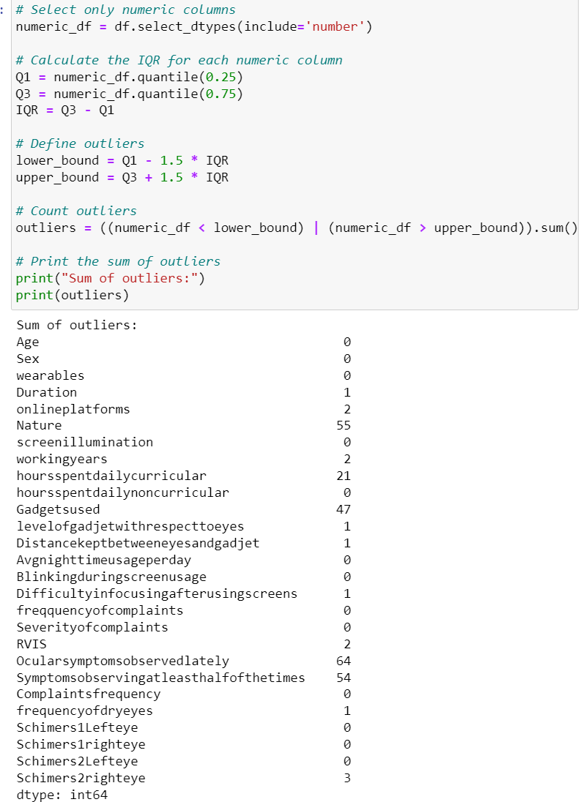
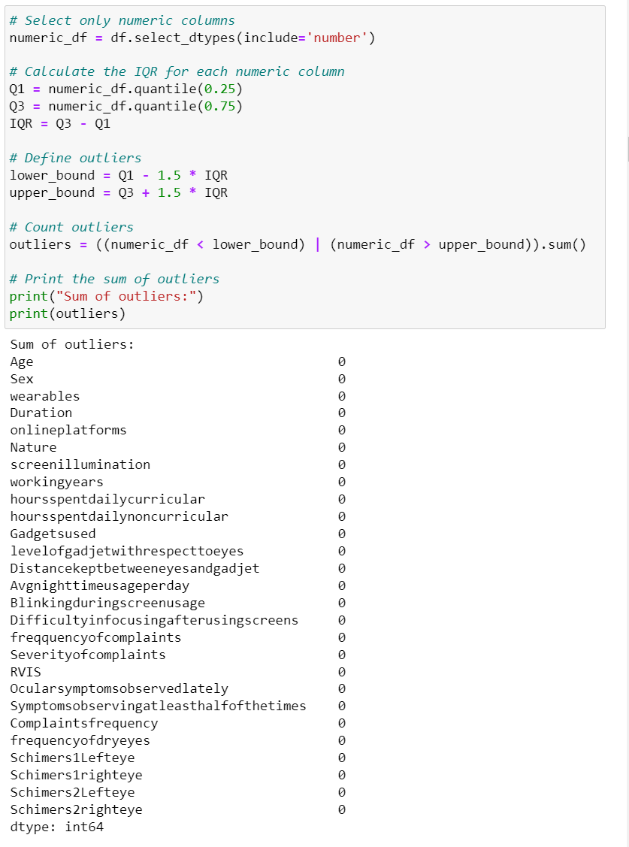
Outline
METHODOLOGY
Outlier Analysis:
Outliers are detected and they are removed
Cleaning NULL values:
Null values are detected and filled with mean fill method.
Train & Test datasets:
We split the data for model building as train data(70%) and test data(30%).

Slide 11
Outline
ALGORITHMS
Accuracy of different algorithms:
1. Random Forest Regressor : 83.20%
2.Linear Regression : 84.69%
3.Ridge Regression : 84.87%
4.Lasso Regression : 81.26%
From the above models the most accuracy is for Ridge followed by Linear regression.
But these have pathetic MSE and R^2 values so we will use Random Forest Regression which has good accuracy score , MSE,R^2 and also Md-APE value.

Slide 12
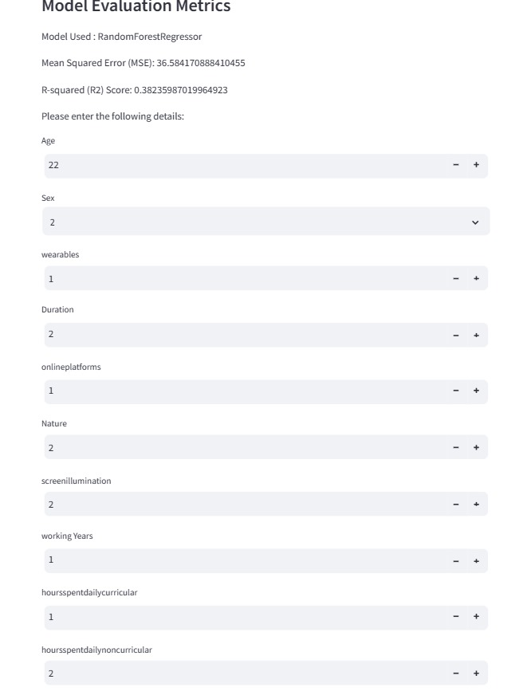
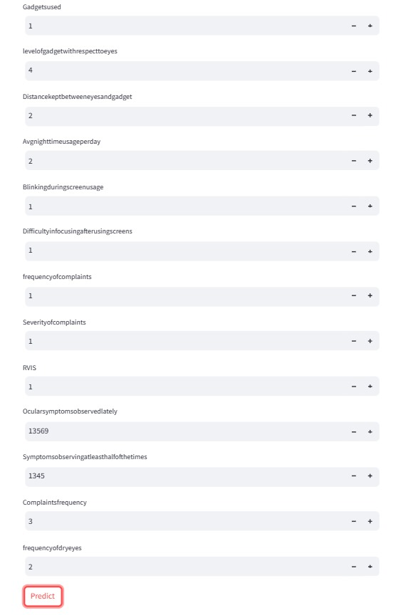
Outline
RESULTS
We built an app to predict schrimer’s test results for both eyes.

Slide 13
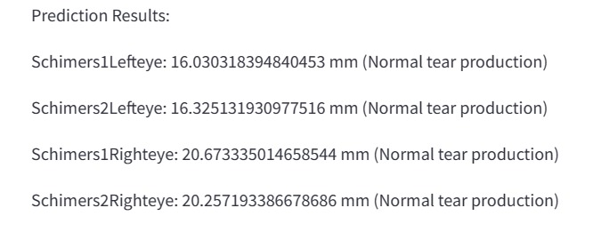
Outline
RESULTS
The prediction result is as follows:

Slide 14
Outline
CONCLUSION
This projects aims at predicting the Schirmer’s test result by using the inputs given by the user.
For this project we have used Random Forest Regression as our model and used stream lit to deploy a web app locally.
Addressing these risk factors through educational interventions promoting healthy screen habits and ergonomic practices is essential to mitigate the adverse effects of prolonged digital screen use on the visual health of undergraduates.
Further research is warranted to explore effective strategies for preventing and managing digital screen-related eye problems in this population.
Further research is warranted to explore effective strategies for preventing and managing digital screen-related eye problems in this population.

